Slide 1
Introduction to NoSQL Databases
Chapter 2

Slide 2
See Chapter 1:
Big Data Challenges:
Volume: BIG data → horizontal scaling/distributed data
Variety: varied data → schemaless databases
Velocity: fast data → NoACID databases

Slide 3
Classical relational database follow the ACID Rules
A database transaction must be
Atomic: A transaction is a logical unit of work which must be either completed with all of its data modifications or nothing at all
Consistent: At the end of the transaction, all data must be left in a consistent state
Isolated: Modifications of data performed by a transaction must be independent of another transaction. Otherwise the outcome of a transaction may be erroneous
Durable: When the transaction is completed, effects of the modifications performed by the transaction must be permanent in the system

Slide 4
The NoSQL movement
RDBMSs put a lot of emphasis on keeping data consistent.
Entire database is consistent at all times (ACID)
Focus on consistency may hamper flexibility and scalability
As the data volume or the number of parallel transactions increases, capacity can be increased by
Vertical scaling: extending storage capacity and/or CPU power of the database server
Horizontal scaling: multiple DBMS servers being arranged in a cluster
Notes:
Relational database management systems (RDMSs) put a lof of emphasis on keeping data consistent. They require a formal database schema, and new data or modifications to existing data are not accpeted unless they comply with this schema in terms of data type, referential integrity, etc.
The way in which RDBMSs coordinate their transactions guarantees that the entire database is consistent at all times. Consistency is uaually a desirable property; one normally wouldn't want erroneous data to enter the system, nor for a money transfer to be aborted halfway through, with only one of the two accounts updated.
Sometimes this focus on consistency may become a burden, because it induces (in some cases unnecessarily) overhead and hampers scalability and flexibility. RDMBSs are at their best when performing intensive read/write operations on small- or medium-sized datasets, or when executing larger batch processes, but with only a limited number of simultaneous transactions.

Slide 5
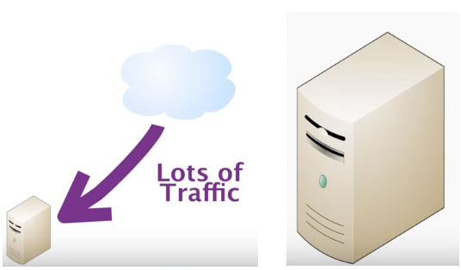
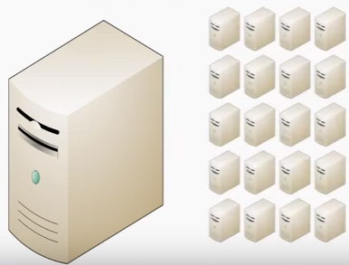
Vertical vs Horizontal scaling
As you get large amounts, you need to scale things.
(1) You can scale things up using bigger boxes
It costs a lot and there are real limits as to how far you can go
(2) You can use lots and lots of little boxes, just commodity hardware, all thrown into massive grids
Relational databases were not designed to run efficiently on clusters. It’s very hard to spread relational databases and run them on clusters
Notes:
As the data volumes or the number of parallel transactions increase, capacity can be increased by vertical scaling (also scaling up), i.e. by extending storage capacity and/or CPU power of the database server. However there are hardware-induced limitations to vertical scaling.
Therefore, further capacity increases need to be realized by horizontal scaling (also known as scaling out), with multiple DBMS servers being arranged in a cluster. The respective nodes in the cluster can balance workloads among one another and scaling is achieved by adding nodes to the cluster, rather than extending the capacity of individual nodes. Such a clustered architecture is an essential prerequisite to cope with the enormous demands of recent evolutions such as Big Data (analytics), cloud computing, and all kinds of responsive web applications. It provides the necessary performance, which cannot be realized by a single server, but also guarantees availability, with data being replicated over multiple nodes and other nodes taking over their neighbor's workload if one node fails.

Slide 6
Vertical vs Horizontal scaling
RDBMSs are not good at extensive horizontal scaling
Coordination overhead because of focus on consistency
Rigid database schemas
Other types of DBMSs needed for situations with massive volumes, flexible data structures and where scalability and availability are more important ➔ NoSQL databases
Notes:
However, RDBMSs are not good at extensive horizontal scaling. Their approach toward transaction management and their urge to keep data consistent at all times induces a large coordination overhead as the number of nodes increases. In addtition, the rich querying functionality may be overkill in many Big Data settings, where applications merely need high capacity to "put" and "get" data items, with no demand for complex data interrelationships nor selection criteria. Also, Big Data settings often focus on semi-structured data or on data with a very volatile structure, where the rigid database schemas of RDBMSs are a source of inflexibility.
None of this means that relational databases will become obsolete soon. However, the "one size fits all" era, where RDMBSs were used in nearly any data and processing context, seems to have come to an end. RDBMSs are still the way to go when storing up to medium-sized volumes of highly structured data, with strong emphasis on consistency and extensive querying facilities. Where massive volumes, flexible data structures, scalability, and availability are more important, other systems may be called for. This need resulted in the emergence of NoSQL databases.

Slide 7
The NoSQL movement
NoSQL databases
Describes databases that store and manipulate data in other formats than tabular relations, i.e. non-relational databases (NoREL would be a better name than NoSQL)
NoSQL databases aim at near linear horizontal scalability, by distributing data over a cluster of database nodes for the sake of performance as well as availability
Eventual consistency: the data (and its replicas) will become consistent at some point in time after each transaction

Slide 8
The NoSQL movement
 | Relational Databases | NoSQL Databases
Data paradigm | Relational tables | Key-value (tuple) based Document based Column based Graph based XML, object based Others: time series, probabilistic, etc.
Distribution | Single-node and distributed | Mainly distributed
Scalability | Vertical scaling, harder to scale horizontally | Easy to scale horizontally, easy data replication
Openness | Closed and open source | Mainly open source
Schema role | Schema-driven | Mainly schema-free or flexible schema
Query language | SQL as query language | No or simple querying facilities, or special-purpose languages
Transaction mechanism | ACID: Atomicity, Consistency, Isolation, Durability | BASE: Basically available, Soft state, Eventual consistency (see further)
Feature set | Many features (triggers, views, stored procedures, etc.) | Simple API
Data volume | Capable of handling normal-sized data sets | Capable of handling huge amounts of data and/or very high frequencies of read/write requests
Notes:
The modern NoSQL movement describes databases that store and manipulate data in other formats than tabular relations, i.e. non-relational databases. The movement should have more appropriately been called NoREL, especially since some of these non-relational databases actually provide query language facilities close to SQL. Because of such reasons, people have changed the original meaning of the NoSQL movent to stand for "not only SQL" or "not relational" instead of "not SQL".
What makes NoSQL databases different from other, legacy, non-relational systems that have existed since as early as the 1970s? The renewed interest in non-relational database systems stems from Web 2.0 companies in the early 2000s. Around this period, up-and-coming web comapnies, such as Facebook, Google, and Amazon, were increasingly being confronted with huge amounts of data to be processed, often under time-sensitive constraints. For example, think about an instantaneous Google search query, or thousands of users accessing Amazon product pages or Facebook profiles simultaneously.
Often rooted in the open-source community, the characteristics of the systems developed to deal with these requirements are very diverse. However, their common ground is that they try to avoid, at least to some extent, the shortcomings of RDBMSs in this respect. Many aim at near-linear horizontal scalability, which is achieved by distributing data over a cluster of database nodes for the sake of performance (parallelism and load balancing) and availability (replication and failover management). A certain measure of data consistency is often sacrificied in return. A term frequently used in this respect is eventual consistency; the data, and respective replicas of the same data item, will become consistent in time after each transaction, but continuous consistency is not guaranteed.
The relational datamodel is cast aside for other modeling paradigms, which are typically less rigid and better able to cope with quickly evolving data structures. Often, the API and/or query mechanism are much simpler than in a relational setting.
Note that different categories of NoSQL databases exist and that even the members of a single category can be very diverse. No single NoSQL system will exhibit all of these properties.

Slide 9
NoSQL what does it mean
NoSQL = Not Only SQL = There is more than one storage mechanism that could be used when designing a software solution
1998: Carlo Strozzi used the term to name his Open Source, Light Weight database which did not have an SQL interface
2009: Eric Evans reused the term as a twitter hashtag (#nosql) for a conference in Atlanta about databases which are non-relational, distributed, and do not conform to atomicity, consistency, isolation, durability

Slide 10
Limitations of NoSQL
SQL
over 40 years old => very mature
Switching from 1 relational database to another is much easier than switching between 2 NoSQL databases
Each NoSQL database has unique aspects
The developer must invest time and effort to learn the new query language and the consistency semantics

Slide 11
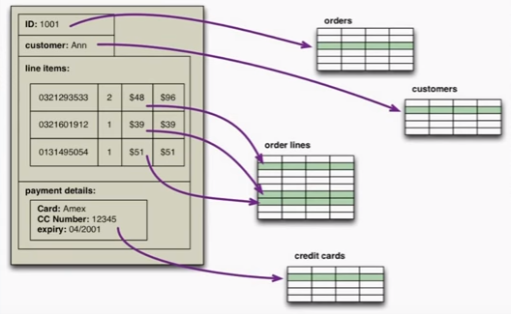
Impedance mismatch
Impedance mismatch
In software: cohesive structures of objects in memory
In databases: you have to stripe the object over multiple tables
NoSQL databases allow developers to develop without having to convert in-memory structures to relational structures

Slide 12
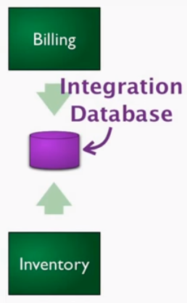
Impedance mismatch
This impedance mismatch problem led to the fact that in the mid-nineties people said: "We think relational databases are going to go away and object databases will be replacing them. In that way we can take care of memory structures and save them directly to disk without any of this mapping between the two.“
But this didn’t happen. Why not?
SQL databases had become an integration mechanism through which people integrated different applications

Slide 13
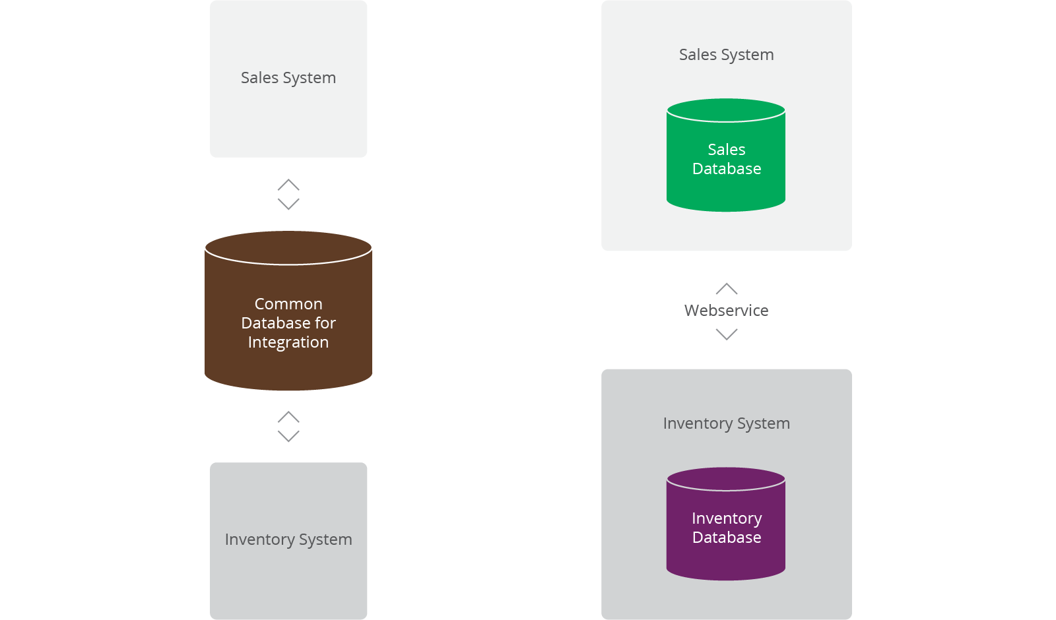
Impedance mismatch
Nowadays there is a movement away from using databases as integration points in favor of encapsulating databases using services.

